Slide 1
Annual Cycle of UTCI Values (1950-2023) for Punjab State

Slide 2
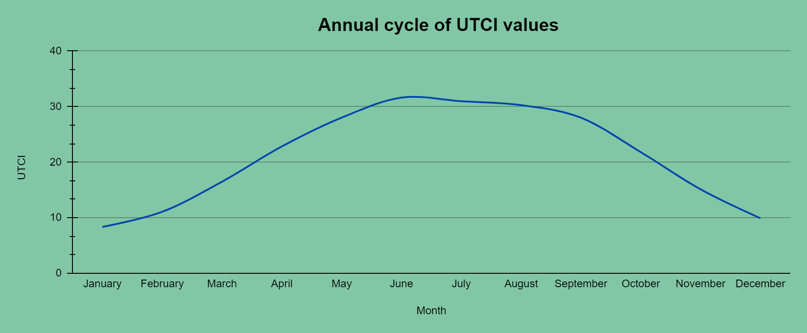

Slide 3
Data Chart
Month | January | February | March | April | May | June | July | August | September | October | November | December
UTCI | 8.359 | 11.068 | 16.482 | 22.840 | 28.020 | 31.627 | 30.974 | 30.269 | 28.012 | 21.809 | 15.113 | 9.911
Time Scale
1950-2023 (Daily Data)

Slide 4
Regional Averaged Coordinates
31.0°N, 75.5°E
Region of Interest
Punjab State
Variable
Universal Thermal Climate Index

Slide 5
Histogram of Very strong heat stress days [utci celsius: 38-46] over punjab .

Slide 6
Month: April
April month did not show any Very strong heat stress days throughout the years

Slide 7
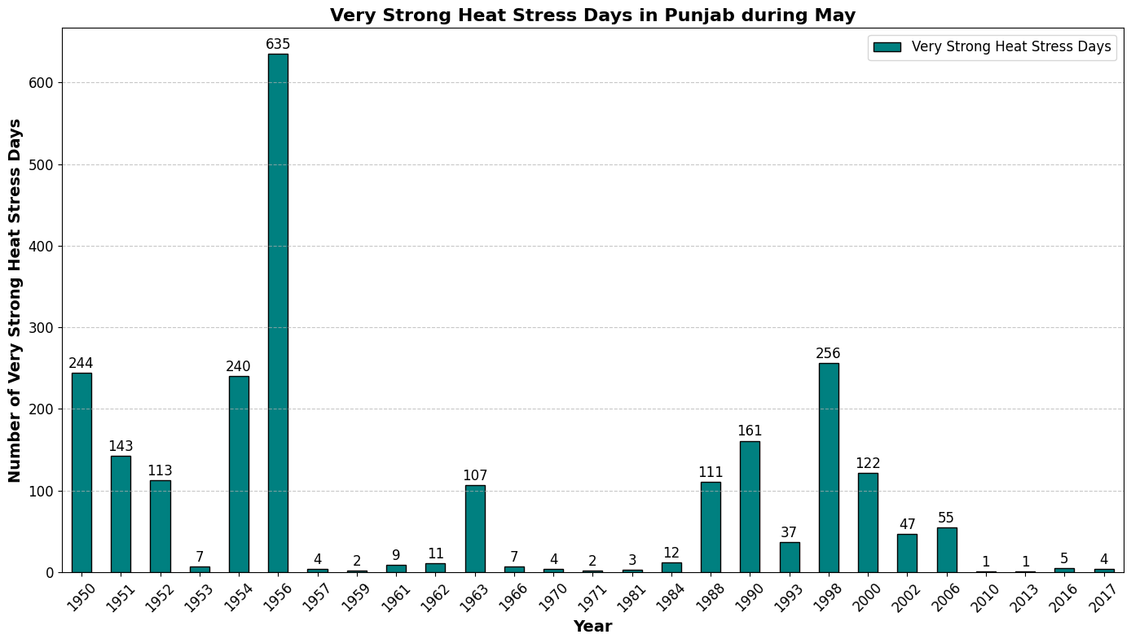
Month: May

Slide 8
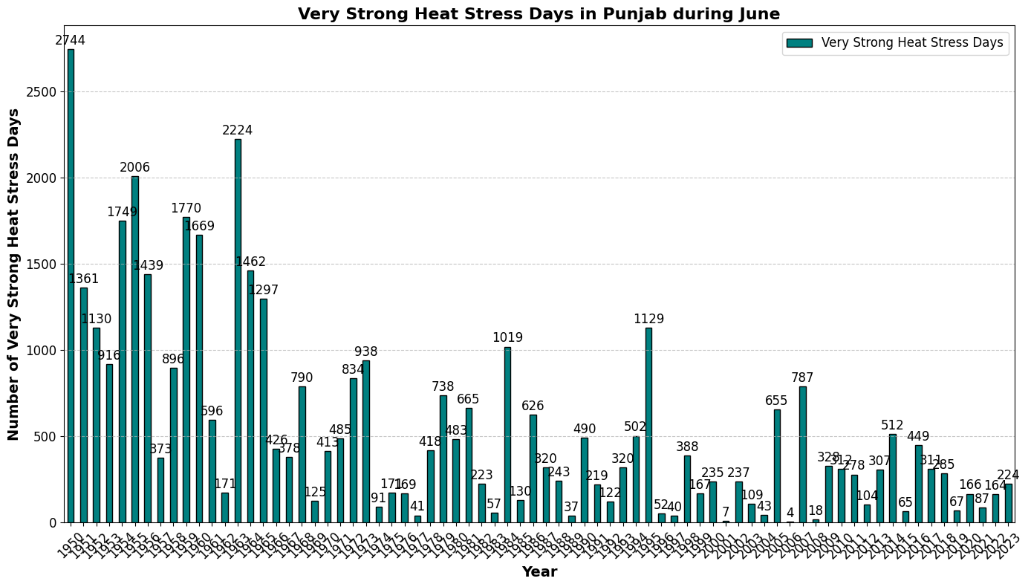
Month: June

Slide 9
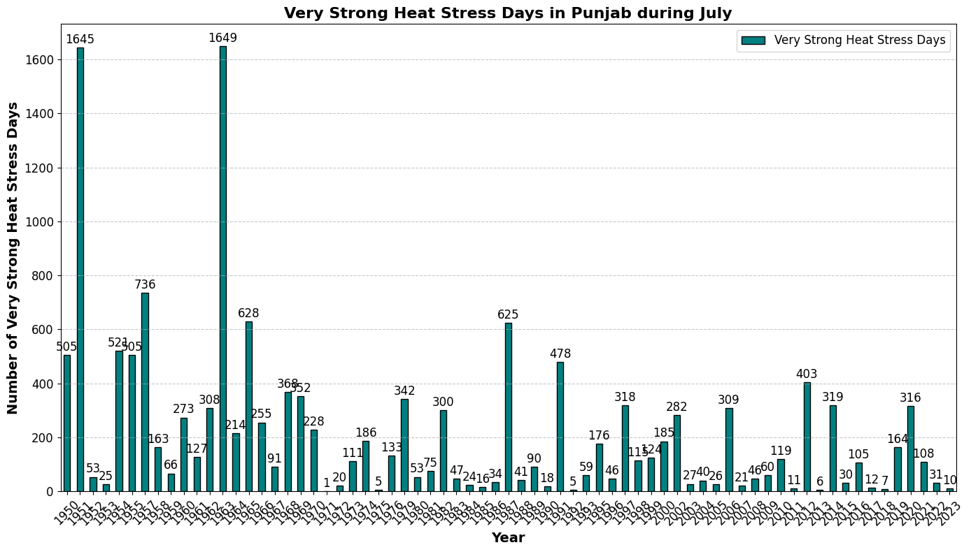
Month: July

Slide 10
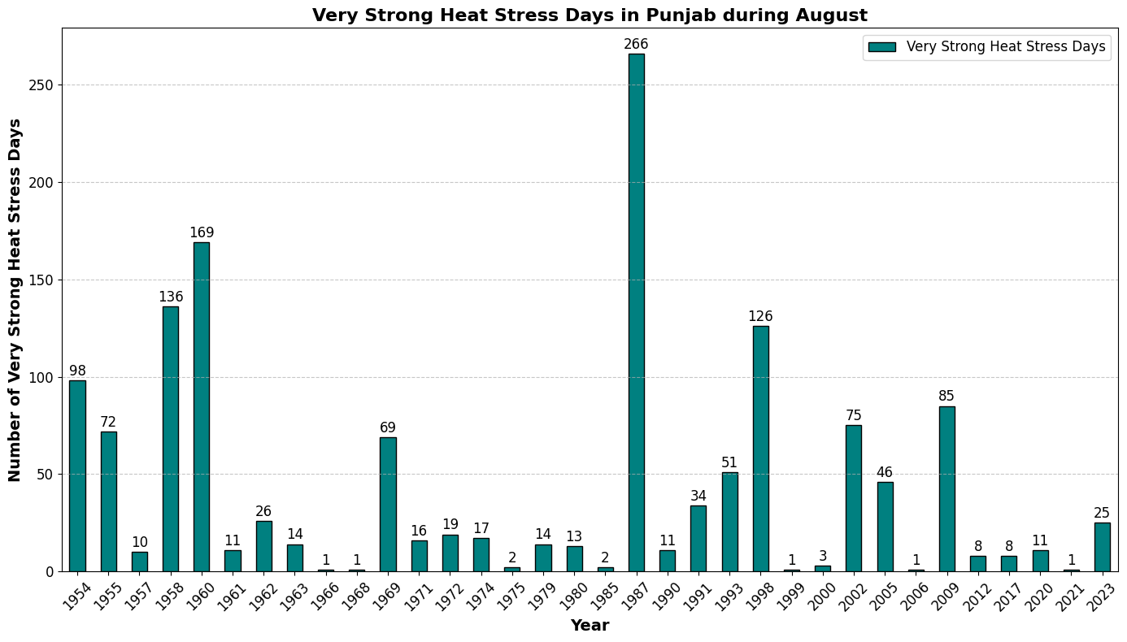
Month: August

Slide 11
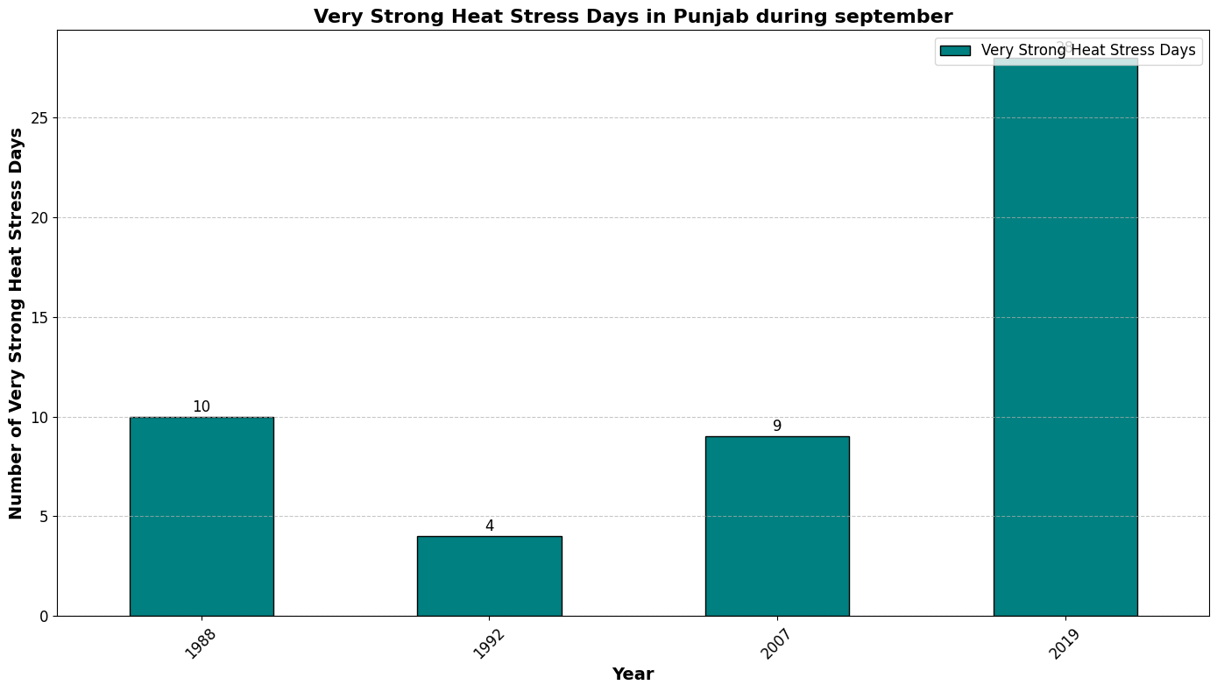
Month: September

Slide 12
Histograms for Average of Months

Slide 13
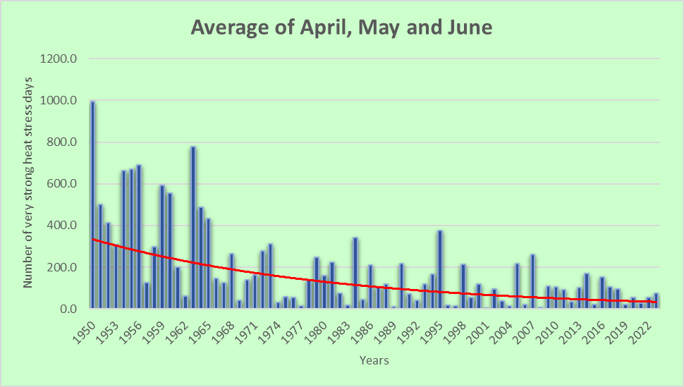

Slide 14
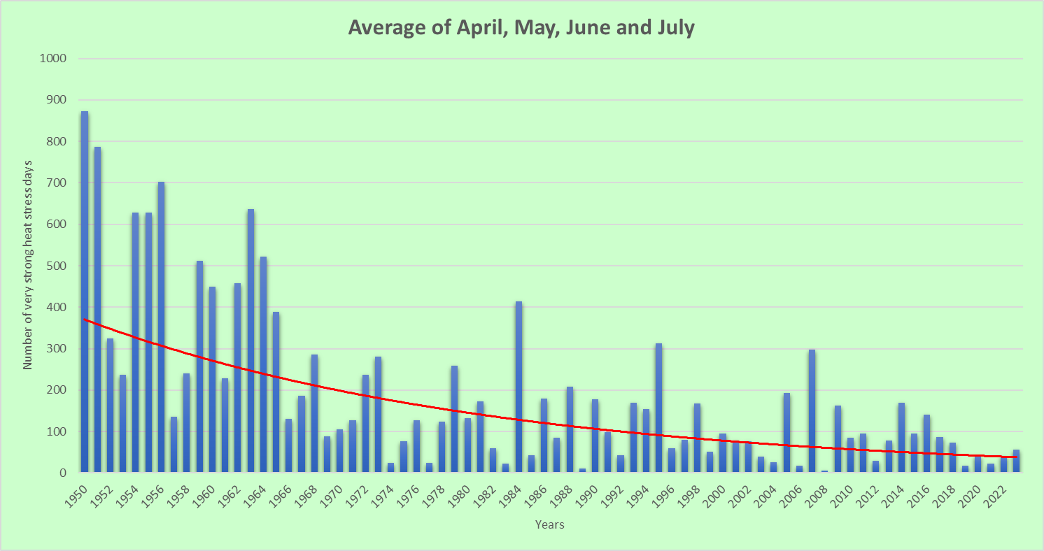

Slide 15
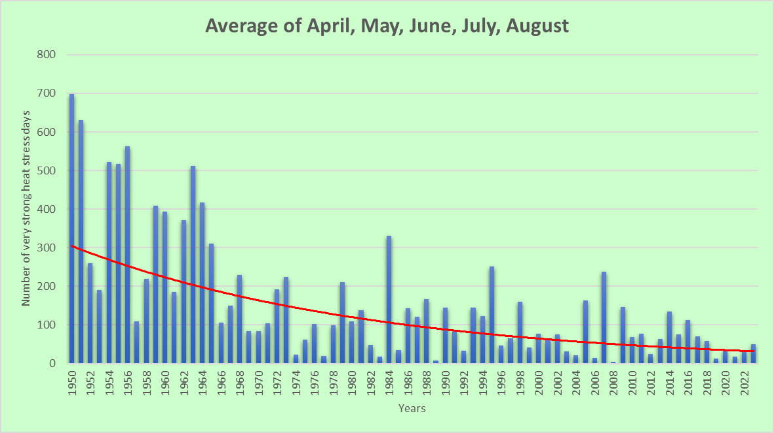

Slide 16
